Slide 1
Operating Systems

Slide 2
A little history
Early computers
  single user systems
  no keyboards
  no monitors
  manual hardware reconfiguration via switches & patch panels
  evolution
    punched cards
    magnetic tapes
http://citeseerx.ist.psu.edu/viewdoc/download?doi=10.1.1.104.1524&rep=rep1&type=pdf

Slide 3
A little history
Using a computer meant
  signing up for a time slot
  walking up to the computer center at the appointed time
  sitting in front of a single monitor and working on your program.
  minimum 15-minute slot
    usually spent 10 minutes on
      setting up a machine
      checking configuration
      loading your program
    only 5 minutes or less of actual computation completed
      wasting 2/3 of the time slot
      time = money
http://citeseerx.ist.psu.edu/viewdoc/download?doi=10.1.1.104.1524&rep=rep1&type=pdf

Slide 4
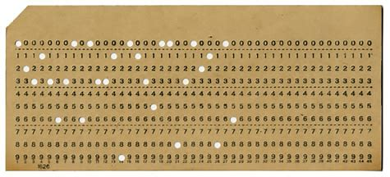
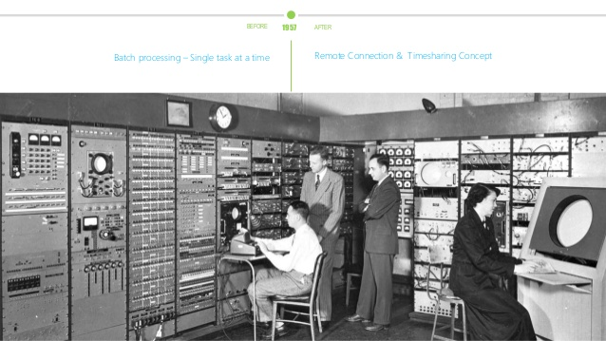
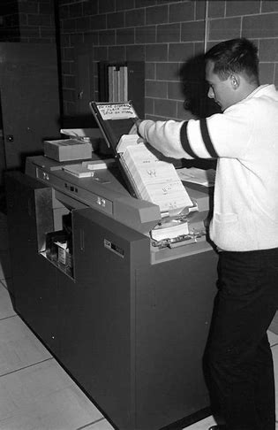
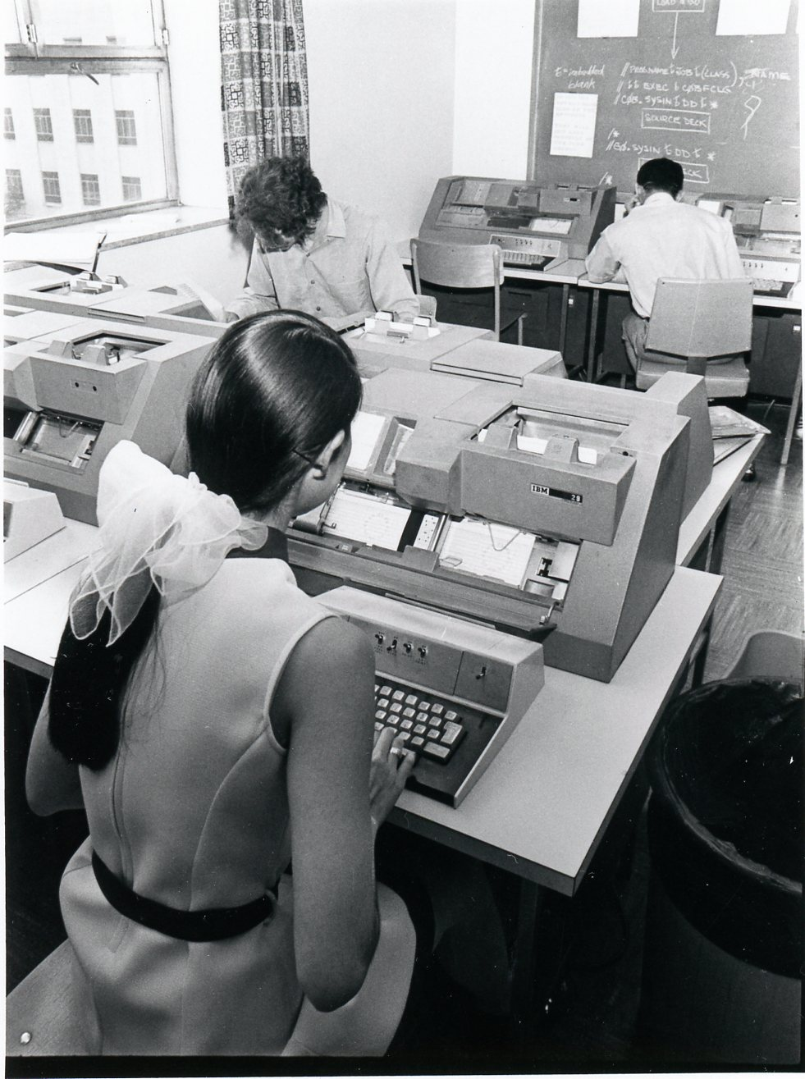
Costs …
The economic cost of all the setup time was staggering.
Companies were charging $300/h for IBM 701 in 1954 = $3,602 in 2025 dollars!
  A lot of time to prepare –> wasted money
  First operating systems -> fix this problem.
    Not UI or multitasking
    Maximize hardware utilization
  Automatically load a new program when the currently executing program completed or crashed.
  This evolved into ‘Batch Processing’ – revolutionary OS concept (still using the approach in data processing)

Slide 5
State of the art … circa 1970s and back again
Timesharing systems
  Parallel sessions!
    Not really – fast switches between processes
  Remote terminals wired to mainframes!
  Command line!
Early real-time systems
  Tiny (often custom) OS’s to run machines .. .like the Apollo guidance system!
  Predictability & real real-time
    Not multitasking – one important task
Centralized computing, and all-control to the OS was the approach
  Mainframe
  Not PC

Slide 6
State of the art … circa 1970s and back again
80s -> Personal Computers
  push for simpler (User) Interfaces (vs. interfaces for experts)
  computing became decentralized
  OS is user-centric
    not operator-centric
Today? OS and computing trends are shifting again
  centralization again
    cloud computing
    data centers instead of mainframes
    GPU farms
    PC = terminals
    welcome to the past
  cost - from $0.011/hour to $0.27/hour
https://aws.amazon.com/emr/pricing/

Slide 7
Types of Operating Systems
Whatever the user model, or commercial model, the Operating System drives the capabilities of the computer system.
The OS capabilities often set boundaries for your application architecture
  you will mostly work with *nix & Windows
  but who knows…
Types of OS architectures
  Monolithic systems
    Everything is in a kernel
  Layered systems
    Hierarchy of functionality
  Microkernels
    Kernel is just a manager

Slide 8
Monolithic
Everything is in a kernel
  process management
  memory management
  file system
  I/O drivers
  Etc
Examples:
  UNIX (classic)
  Linux
  MS-DOS
Pros:
  Really fast
    Any functionality in 1 call away
Cons:
  One bug -> everything crashes
Software
Early computer systems
Basic embedded controllers circa 1980s
Kernel

Slide 9
[Semi]-Layered
Theory
DOS
Application
Application
Each layer talks to the next layer
stability
isolation
modularity
but
  performance
  special cases
  legacy support
result ->
Examples:
  none (pure)
System Programs (resident)
System Programs (resident)
Device Drivers
Device Drivers
BIOS
BIOS
‘BIOS’ is in chips, and ‘boots’ the OS
Basic Input/ Output Services
Basic Input/ Output Services

Slide 10
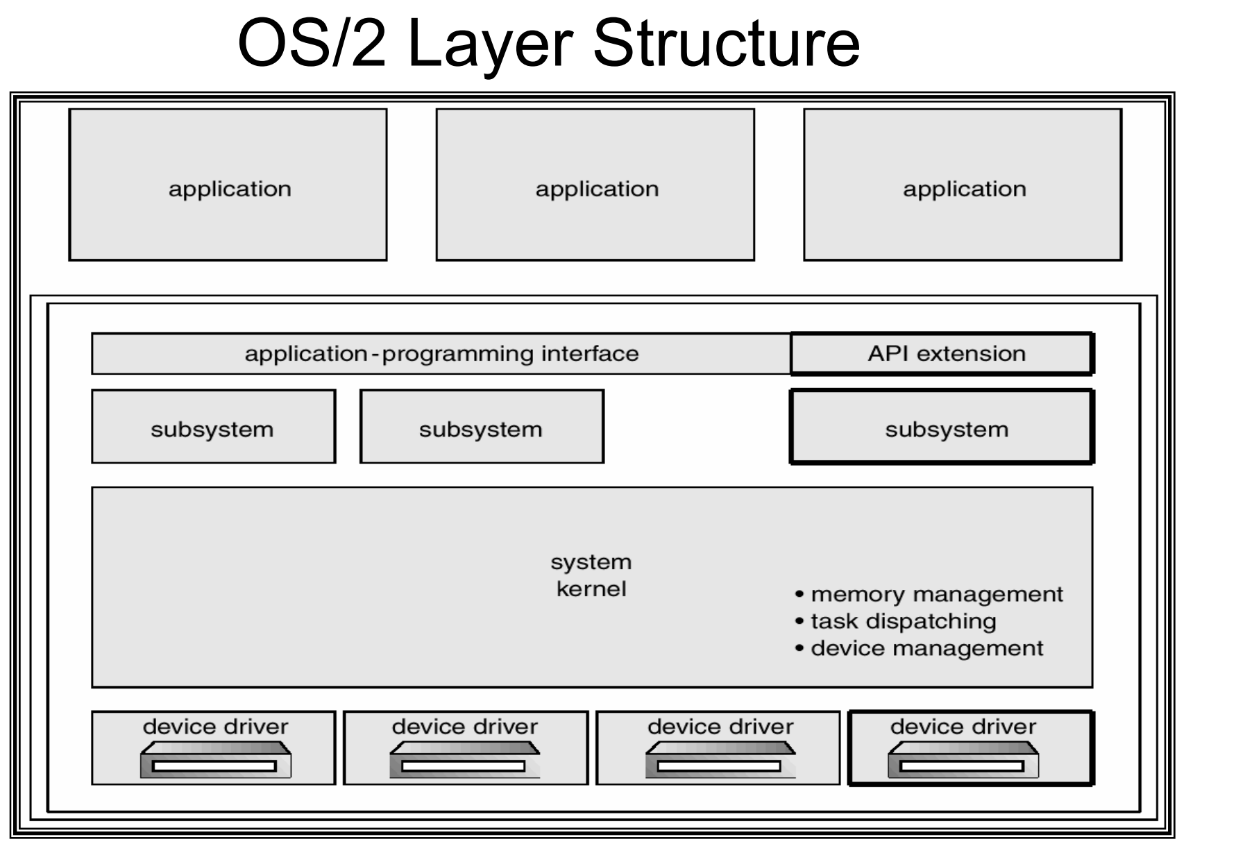
Improved OS architectures
Enforced layers
Advantages?
Isolation
Stability
Issues?
Lack of applications
No backward compatibility
Outcome?
Death
Notes:
But why did OS/2 disappear? Lack of applications; no backward compatibility with suite of applications. But was the right direction

Slide 11
Microkernel
Kernel:
  inter-process communications
  scheduling
  some hardware access
User space:
  everything else
    device drivers
    file system
    network stack
    etc
Pros:
ultra-modular
ultra-reliable
ultra-secure
maintainability
  decoupled
  update just one component
small => portability
Cons:
performance
complexity
does not exist
  QNX & couple of others

Slide 12
Types of modern OSs
Linux – monolithic
  PC
  Android
  ChromeOS
MacOS (pre OS X) – monolithic
MacOS (modern, iOS) – hybrid (monolithic + microkernel)
Windows – monolithic
  95, 98, ME
Windows – hybrid (monolithic + microkernel)
  NT-family – NT, 2000, XP, 7+
  organized in layers

Slide 13
Kernel Space and User Space …
Early computers:
  Run everything in one address space
  1 mistake in 1 program can crash everything
  steal data from memory
  artmoney
Solution – separate:
  trusted code / kernel space
    OS
    drivers
    full access to HW + memory
  untrusted code / user space
    user programs
    limited privileges
    no access to HW
    no access to kernel space
    still can screw each other
Multi-programmed OS With Memory Protection
  each process – separate virtual address space
    believes it’s the whole memory
      starting with address 0
    translation table: virtual -> real addresses
    10 processes * 4gb = 40gb, physical memory – 8gb
    how? Swap / page file
  protects processes from each other
    something crashed? localized
• Dual-mode operation
  CPU switches between kernel and user modes
    each instruction with a flag
    to restrict privileges

Slide 14
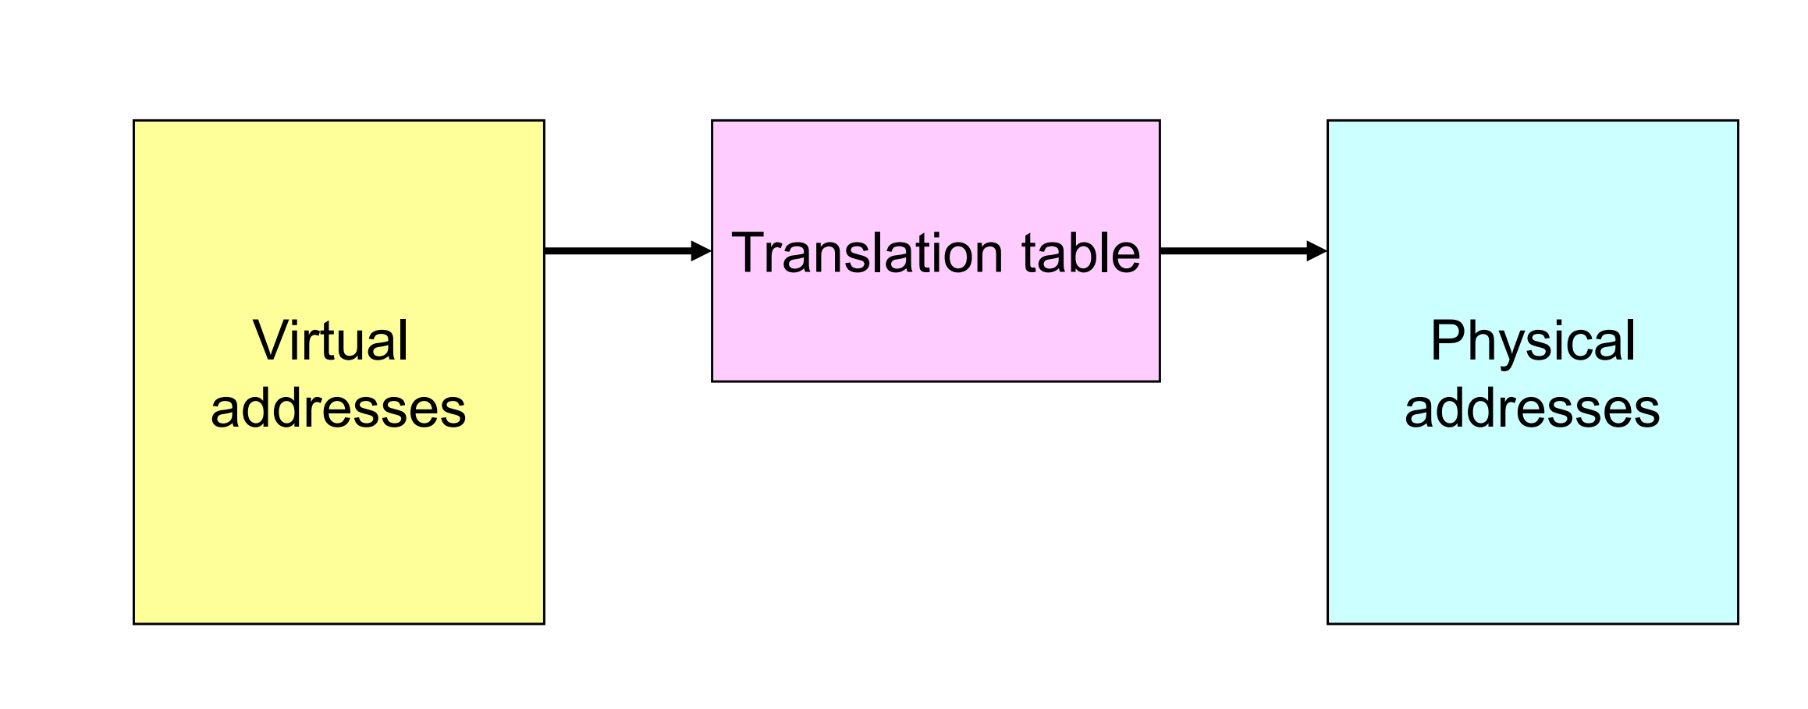
Address Translation
Why do you get kernel panic and blue-screens?
Drivers are not perfect
Corrupt somebody’s memory
Virtual Memory
What is swap space?
Translation provides protection
  Processes cannot talk about other processes’ addresses, nor about the OS addresses
OS uses physical addresses directly
  No translations
Notes:
Usually low level drivers corrupt memory that is not meant for their use
OS frees up physical memory by saving memory, state, on HDD. It ‘swaps’ out RAM to disk (e.g. idle applications). If you have a lot of swapping, it will slow down performance

Slide 15
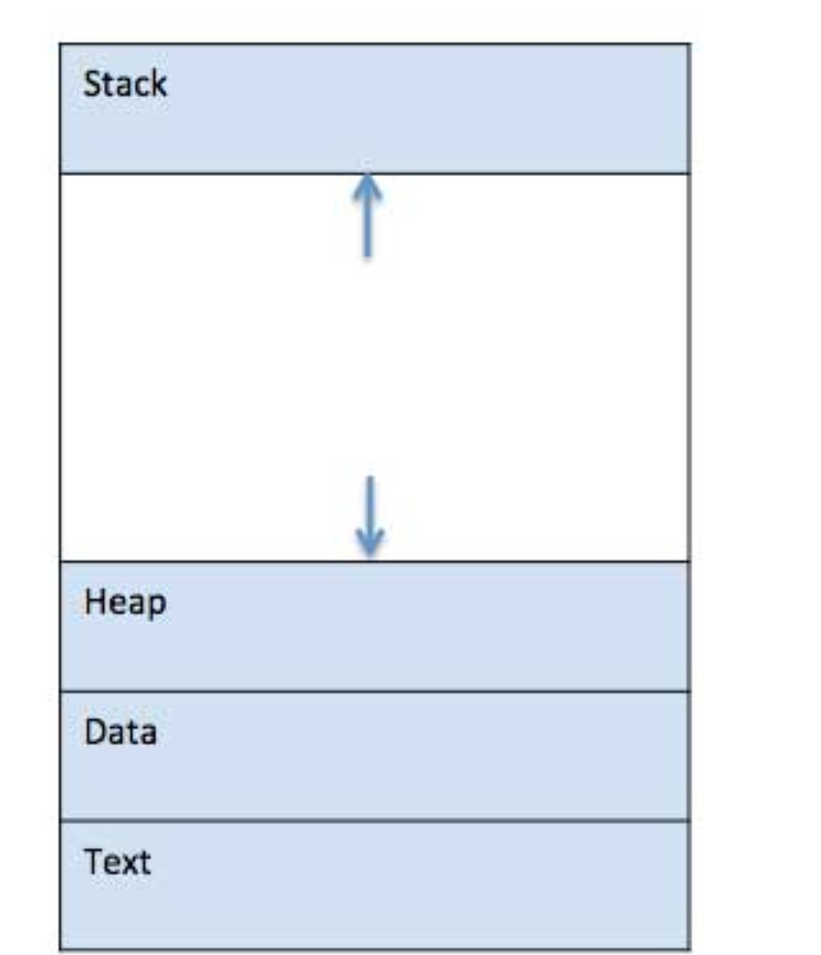
How does an application ‘run’?
 | Component & Description
1 | Stack Temporary data - function parameters, return address and local variables.
2 | Heap This is dynamically allocated memory to a process during its run time.
3 | Text Compiled instructions.
4 | Data This section contains the global and static variables.
Process vs. Thread: The above is a PROCESS!

Slide 16
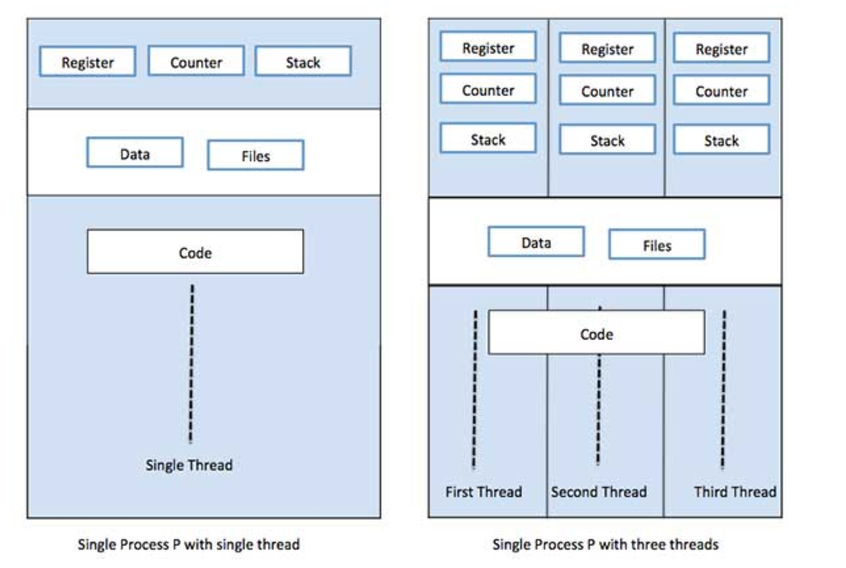
Process vs. Thread
Process | Thread
Process is heavy weight or resource intensive. Creation takes time. | Thread is light weight, taking lesser resources than a process.
Process switching needs interaction with operating system. | Thread switching does not need to interact with operating system.
In multiple processing environments, each process executes the same code but has its own memory and file resources. | All threads can share same set of open files, child processes.
If a process is blocked, you have to wait. | While one thread is blocked and waiting, a second thread in the same task can run.
Multiple processes without using threads use more resources. | Multiple threaded processes use fewer resources.
In multiple processes each process operates independently of the others. | One thread can read, write or change another thread's data.
Processes
  inside of a thread
  share code / text & data & heap & resources
Notes:
Architectural note: Choice of communication and process/ module separation!
https://www.tutorialspoint.com/operating_system/os_quick_guide.htm

Slide 17
Multi-processing
How does an OS run multiple applications?
Co-Operative Multiprocessing
  oldest
Timesharing scheduling
  traditional *nix
Priority pre-emptive multi-tasking
  modern OSs
Address space isolation (see prior slides)
Technically, multiprocessing can occur w/o this … but watch out

Slide 18
Co-Operative Multitasking
one program can block everything
background UI freeze
All processes are memory resident
Running process has full control of CPU
It must explicitly ‘yield’ control to allow another process to run
Process 1
Process 2
Process 3
Executable code segment
Executable code segment
Executable code segment
Yield
Yield
Yield
e.g. Windows pre-Windows 95
CPU

Slide 19
Timesharing Multitasking
Processes (tasks) are assigned a ‘time to run’ (sometimes by priority)
OS Schedules a time slot for each
Runs tasks until time expires
Switches context and runs next priority process
but some animals are more equal
  e.g., UI
  how to create Orwell System?
Task 1
Task 2
Task 3
Task 4
Task 5
OS
CPU

Slide 20
Priority Pre-emptive Multitasking
Processes (tasks) are assigned a priority
OS Schedules a time slot for each
Runs tasks until time (per priority) expires
Interrupt triggers OS
Switches context (under control of OS) and runs next priority process (pre-empts process, even in the middle of execution)
Task 1
Task ID | Priority
1 | 1
2 | 1
3 | 2
4 | 3
5 | 2
Run Pri. 1
Task 2
Run Pri. 2
Task 3
Task 5
Run Pri. 3
Task 4
OS
e.g. modern OSes: Windows, Linux, MacOS
CPU

